Slide 1
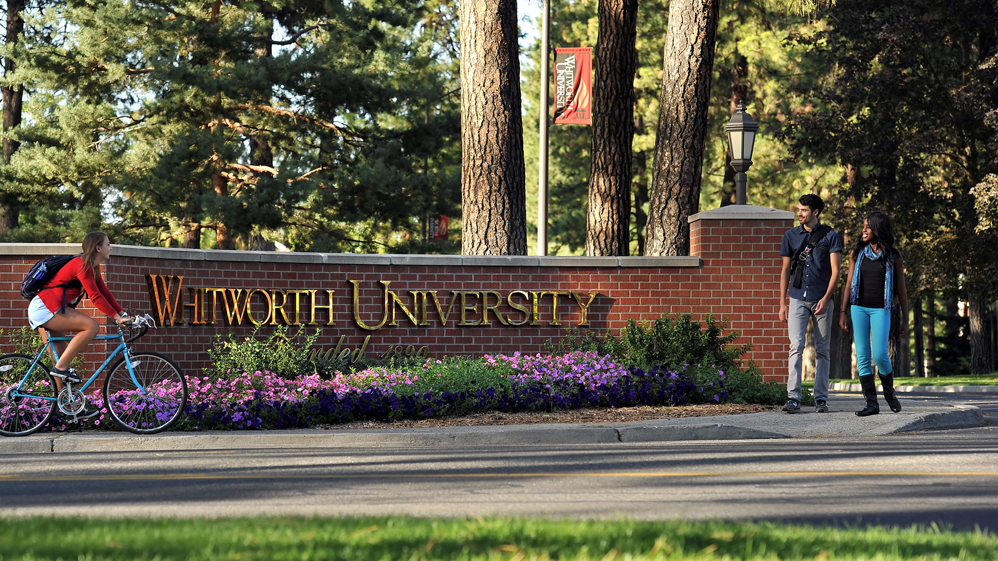


Dynamic Class Scheduler
created by
&
makrasnov100 (GitHub)
yfedas57 (GitHub)
Kostiantyn Makrasnov
Yuriy Fedas

Slide 2

Problem Definition
Program needs to provide a
visually organized and time-optimized table of any student’s courses.
Considerations:
Course info stored in an Excel File
Student knows his/her courses
Courses may have more that one section

Slide 3
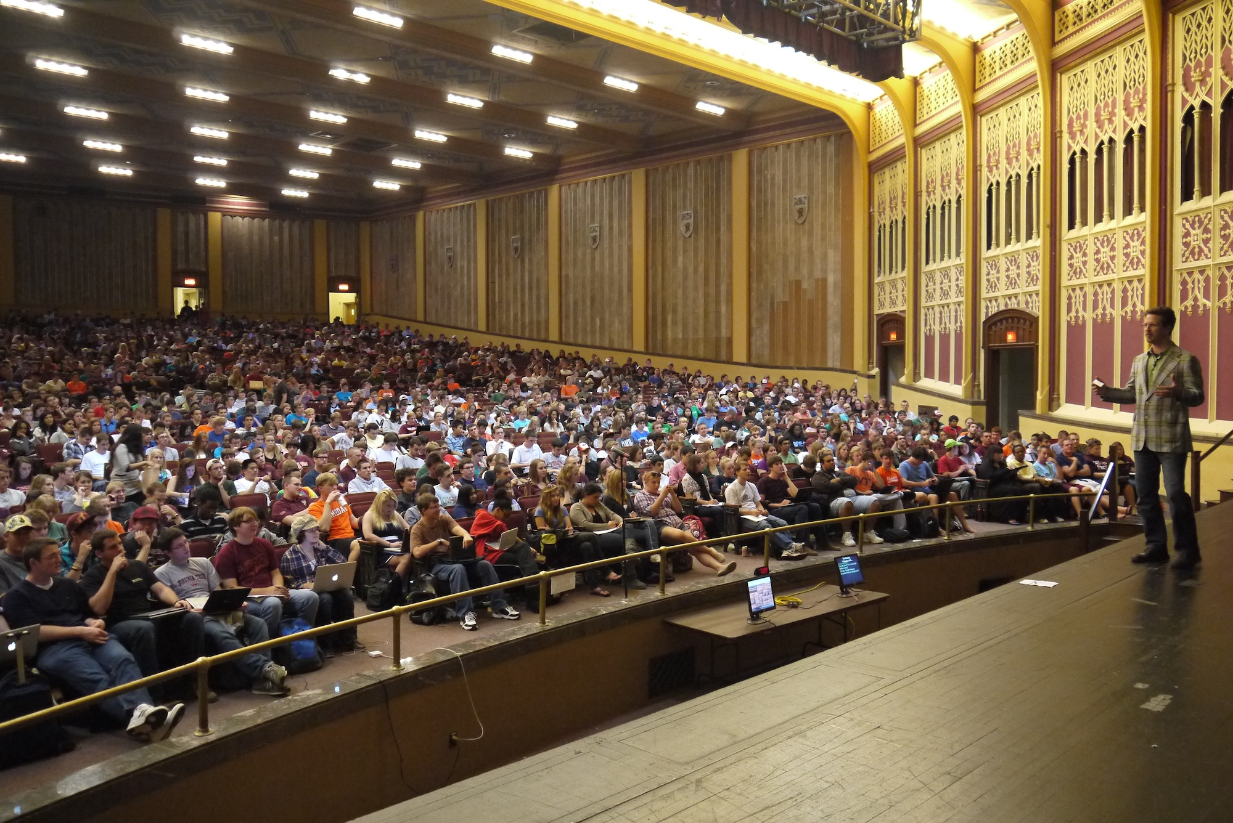

Challenges
Requirements
Prompt user for name & term
Read excel data into classes
Display all courses for selection
Allow user to add/delete courses
Optimize from given sections
Display timetables for selection
Display final “savable” form
Parsing/Filtering course data
Developing schedule algorithm
Using C# Graphics class
Not Overusing memory

Slide 4

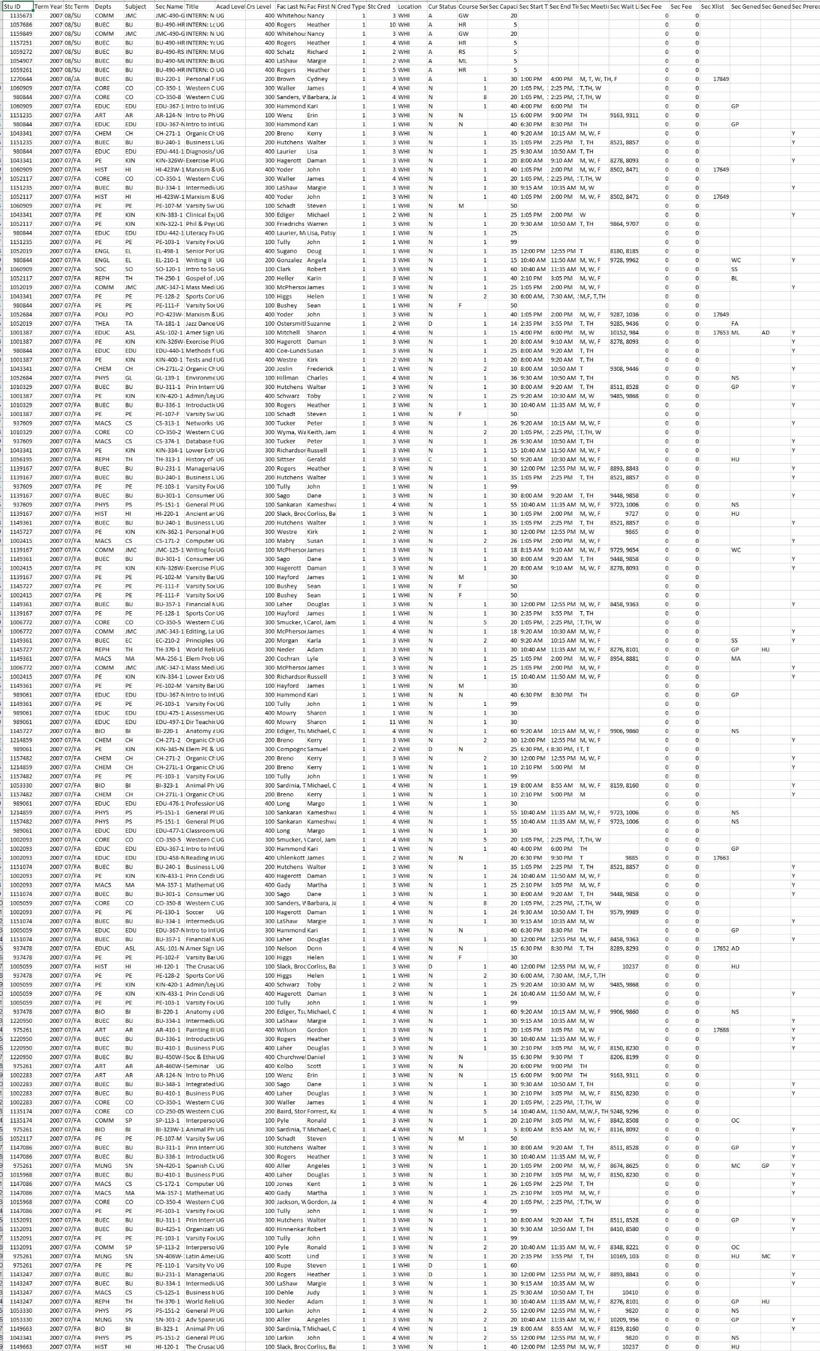
UML Diagrams
Was parsed with by these…
Was used by these…
Was stored in these…
This
Data…

Slide 5

Solution Approach
Why windows forms?
Use of ExcelReader library
“Basic” vs. genetic algorithm
Optimization process
Saving process

Slide 6
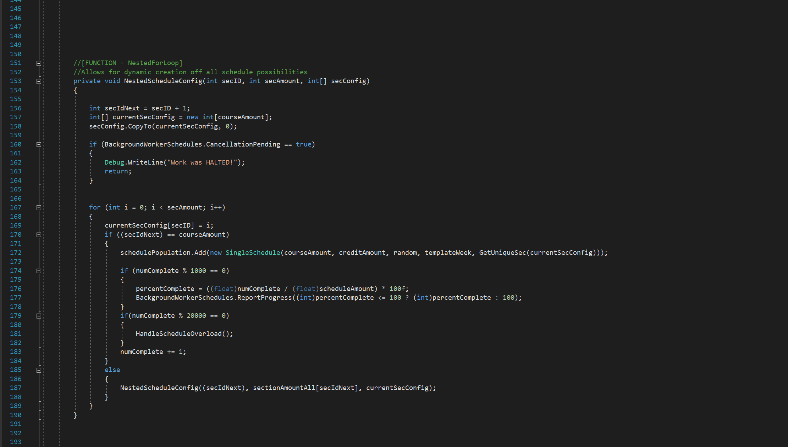
Distinctive Aspects
Schedule Recursion Function
Creates ALL schedules
Reports progress
Supports cancelation
Memory conscious

Slide 7

Image Credits
Title BG - https://www.quantamagazine.org/computer-science/
Large Lecture Class - https://www.theodysseyonline.com/lecture-halls-greatest-flaw-laptops?altdesign=socialux&utm_expid=.cZCE7oX8QCubI-ziFLsOXg.1&utm_referrer=https%3A%2F%2Fwww.google.com%2F
Happy Students - https://www.huffingtonpost.com/2014/08/10/what-makes-students-happy_n_5654833.html
CPU - https://www.tekrevue.com/tip/restrict-apps-cpu-cores-processor-affinity/
Binary Wave - https://education.nsu.ru/summerschools_computing/

